Slide 1
SUB 05:83 Meadowbrook Rural Cluster Subdivision
Tuesday, July 9, 2024
Todd Fortune
Director of Planning

Slide 2
SUB 05:83 Meadowbrook Subdivision – Background
An amendment to the conditions on the original A-1 rural cluster subdivision request pursuant to Section 19-7-2 of the Subdivision Ordinance with respect to 125.95 acres of Tax Map 12, Section 21, Parcels A and B Tax Map 12, Section 21, Parcels 1 through 33, and Tax Map 12, Section A, Parcel 4.
The affected property is located southwest of the intersection of Route 607 (Bybee Road) and Route 613 (Bybees Church Road) and is accessed via Meadow Brook Lane, a secondary road extending west from Route 613.

Slide 3
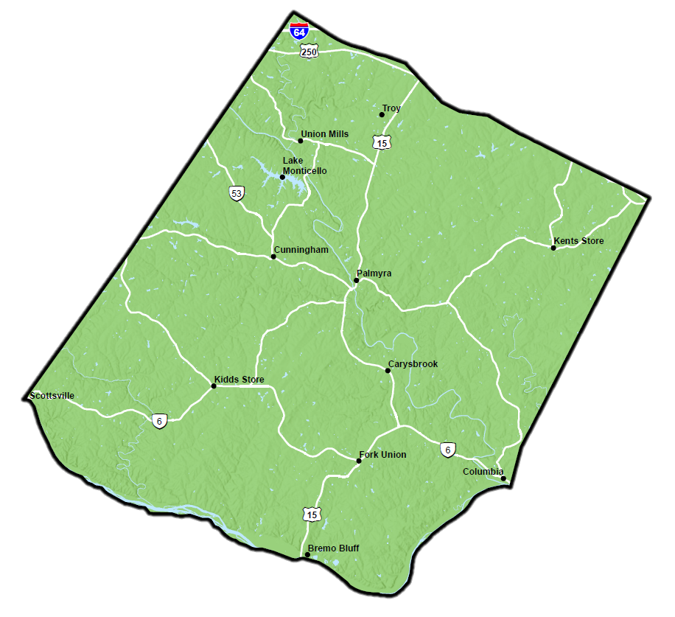
Meadowbrook Subdivision Site Location

Slide 4
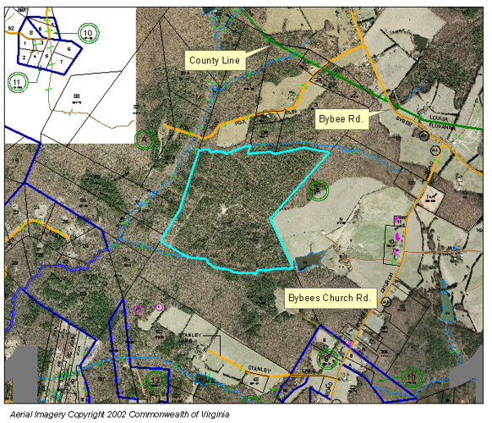
Meadowbrook Subdivision Parcel Map

Slide 5
SUB 05:83 Meadowbrook Subdivision – Background cont.
The subdivision was approved by the Board of Supervisors in 2005 subject to 15 conditions:
1. Prior to preliminary plan approval, correct the yield plan building setback from 100 to 125 ft.;
2. Prior to preliminary plan approval, ensure that all lots meet the 60 ft. minimum frontage requirements, including corner lots;
3. Prior to preliminary plan approval, ensure that plan is meeting all scale requirements;
4. Prior to final plat approval dedication and acceptance of proposed Meadowbrook lane to ensure suitability for acceptance into the Secondary Highway System;
5. The open space is proposed to be owned and maintained by a homeowners association;
6. Open space contains a recreation area and walking trails connected to all cul-de-sacs by easements;

Slide 6
SUB 05:83 Meadowbrook Subdivision – Background cont.
7. Open space will contain a playground, picnic area, basketball/tennis court, and a play field;
8. An engineered fire suppression well and a minimum 10,000 gallon holding tank will be located at the entrance;
9. Design a minimum of 350 feet of open space between lots in each cul-de-sac;
10. Applicant is required to meet the hydrological test requirements which state that the division has the “capacity to equal 1 gallon per minute for each proposed lot after a 48-hour continuous constant test rate”;
11. Provide trails for non-motorized traffic in the design of the development;
12. Full erosion and sediment control plan approved by Fluvanna County of Fluvanna;

Slide 7
SUB 05:83 Meadowbrook Subdivision – Background cont.
13. VPDES General construction permit required through the Department of Conservation and Recreation;
14. Army Corps of Engineers and DEQ approval for any possible wetland and stream impacts if any are proposed;
15. VDOT has indicated that a 100-foot taper with a 150 ft. turning lane is required at the entranceway to Rt. 613.
The project was broken into phases. Phase 1 is the entrance road to the subdivision. Phase 2, completed, consists of 12 residential lots. Phase 3, completed, consists of 21 lots. Phase 4, under construction, consists of the remaining 13 lots.

Slide 8
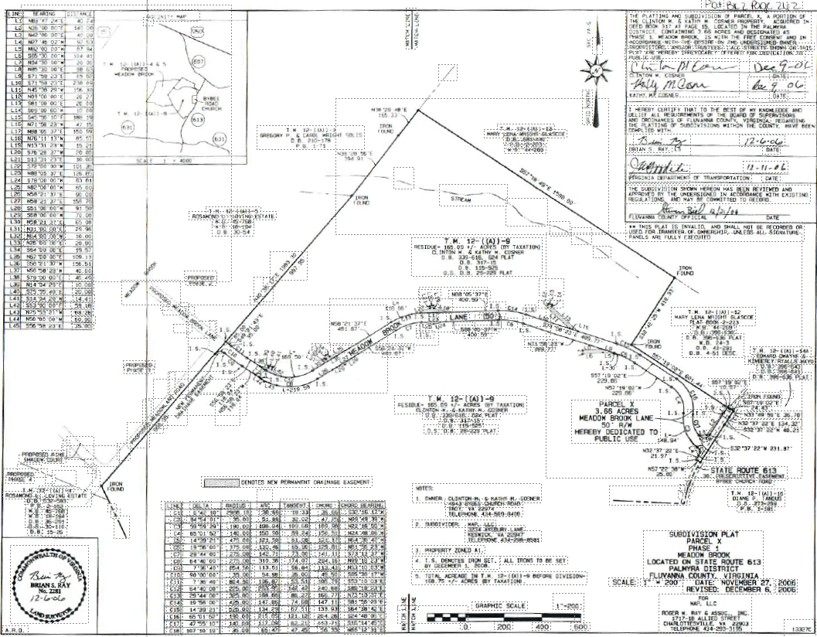
Meadowbrook Subdivision – Phase I

Slide 9
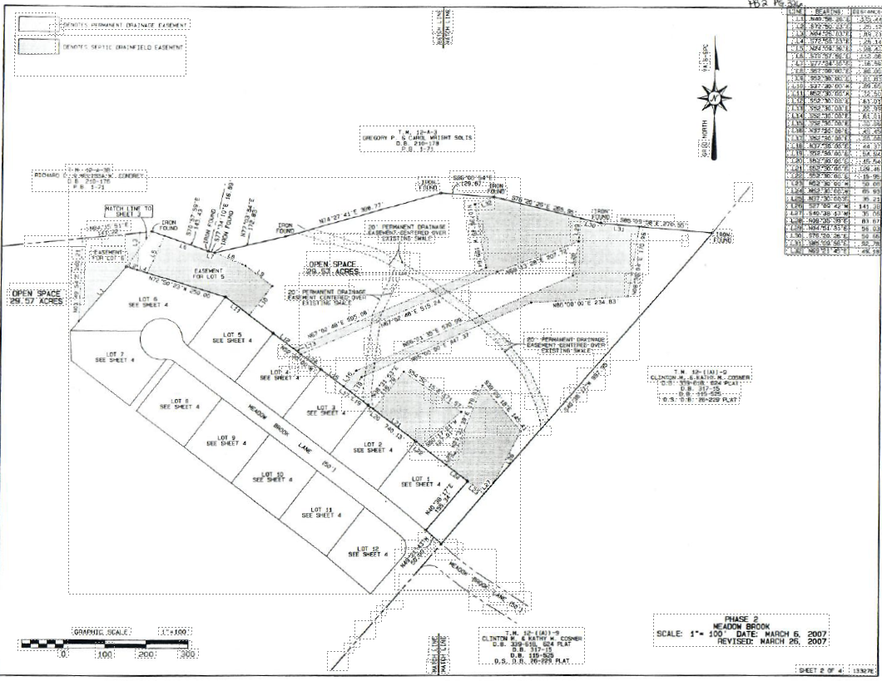
Meadowbrook Subdivision – Phase II

Slide 10
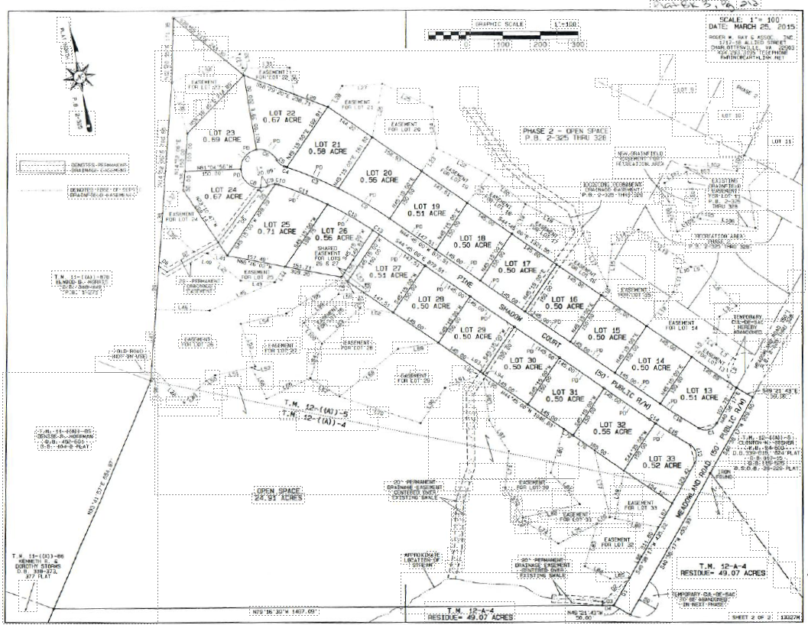
Meadowbrook Subdivision – Phase III

Slide 11
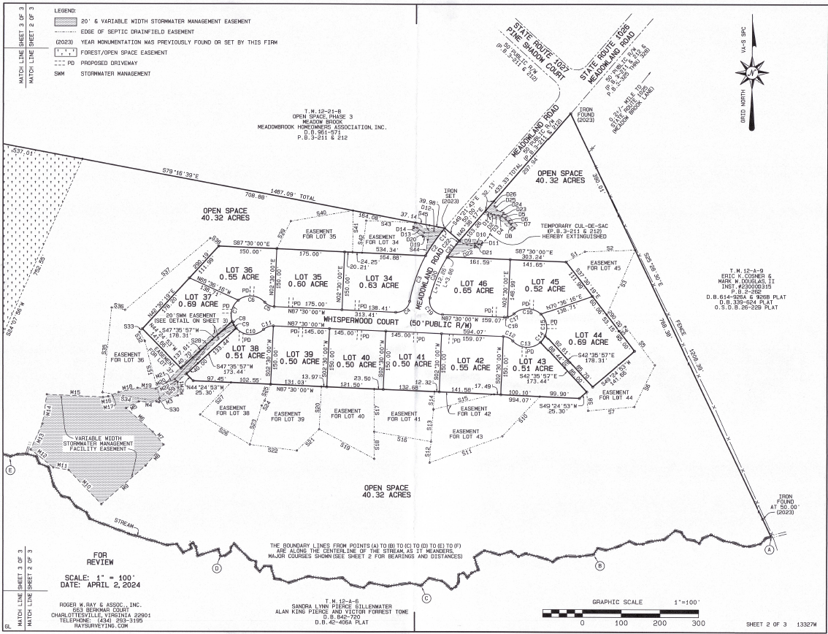
Meadowbrook Subdivision – Phase IV

Slide 12
SUB 05:83 Meadowbrook Subdivision – Background cont.
The developer and the Homeowners Association have requested that conditions 6, 7, 8, and 11 be removed. Their reasoning for this request is as follows:
Condition 6 – The Homeowners Association (HOA) feels that this should be their decision to make, as these amenities would create extra costs for the HOA to cover the capital expenditures and long-term maintenance costs.
Condition 7 – A large majority of the residents in this subdivision are retirees. Consequently, there would be few (or no) users for these amenities.
Condition 8 – A new fire station has opened within two (2) miles of the entrance to the subdivision, rendering the fire suppression system unnecessary.
Condition 11 – The HOA feels that this should be their decision to make, as these amenities would create extra costs for the HOA to cover the capital expenditures and long-term maintenance costs.

Slide 13
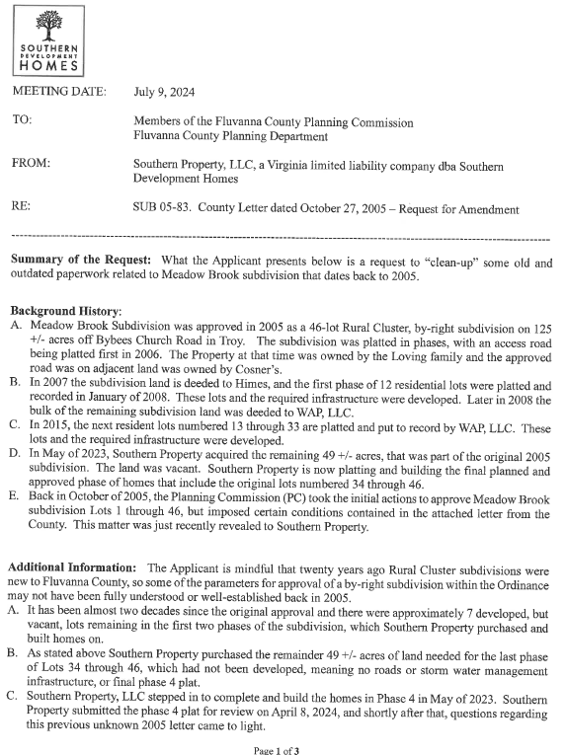
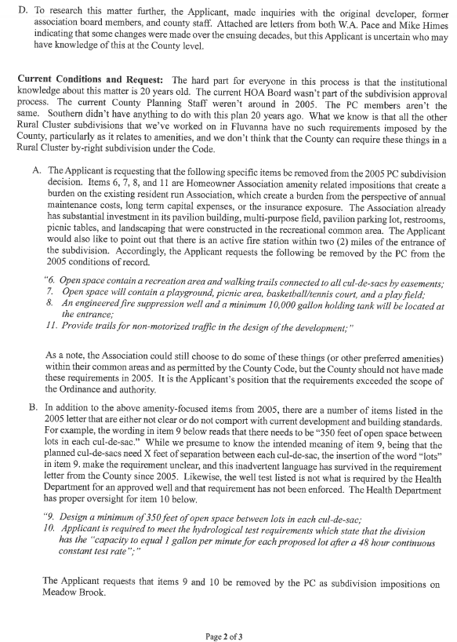
SUB 05:83 Meadowbrook Subdivision – Developer Letter

Slide 14
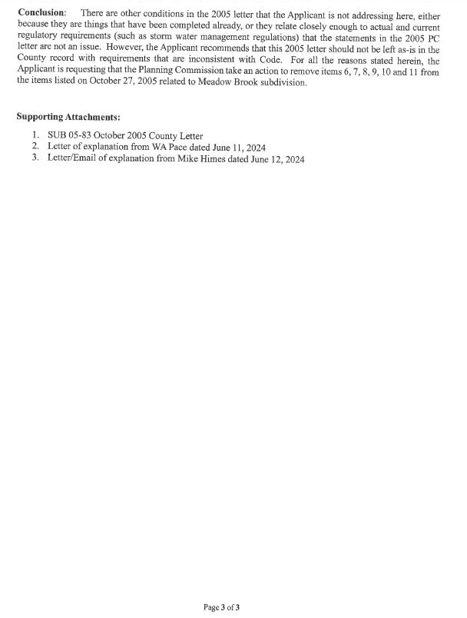
SUB 05:83 Meadowbrook Subdivision – Developer Letter

Slide 15
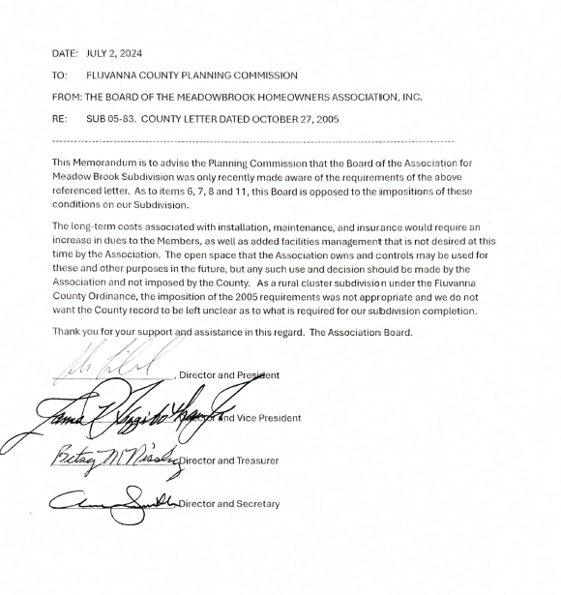
SUB 05:83 Meadowbrook Subdivision – HOA Letter

Slide 16
Planning Commissioners Discussion
SUB 05:83 Meadowbrook Subdivision

Slide 17
SUB 05:83 Meadowbrook Subdivision Motion
I move that the Planning Commission (approve / deny / defer) SUB 05:83, a request for an amendment to the conditions to remove conditions 6, 7, 8, and 11 of the rural cluster subdivision approved for 46 lots pursuant to Section 19-7-2 of the Subdivision Ordinance with respect to 125.95 acres of Tax Map 12, Section 21, Parcels A and B Tax Map 12, Section 21, Parcels 1 through 33, and Tax Map 12, Section A, Parcel 4.

