Slide 1
ZMP 24:01 Pratap Rai Zoning Proffer Amendment Deferral Request
Tuesday, July 9, 2024
Todd Fortune
Director of Planning

Slide 2
ZMP 24:01 Rai Proffer Amendment - Background
The owner, Mr. Pratap Rai, had requested an amendment of the proffers for ZMP 09:04 with respect to 1.27 acres of Tax Map 5 Section A Parcel 54 – 21453 James Madison Highway.
The property was rezoned from A-1 to B-1 in 2009, As part of the rezoning, per a request from owner at the time (James H. Watson), the rezoning was subject to submitted proffers which limited allowed uses to:
Retail stores
Offices
Daycare centers
Commercial greenhouses
One- or two-family dwellings
The amendment requested by Mr. Rai would permit previously proffered out commercial uses such as a personal services establishment. At the time, there was a beauty parlor operating out of the building.

Slide 3
Rai Proffer Amendment – Background cont.
At its May 2024 meeting, the Planning Commission deferred the matter until its June 2024 meeting.
At the June meeting, the Commission granted a second deferral until tonight’s meeting.
The property is currently served by a private well and septic system. The deferrals were intended to give Mr. Rai time to bring both into compliance with Virginia Department of Health Regulations.
Since the June meeting, Mr. Rai has closed the beauty parlor. He has also advised that once both public water and sewer are available to this property, he would like to place another business in the space formerly used as a beauty parlor.
Public water is available now. The availability of public sewer is dependent upon the completion of infrastructure in the area. Mr. Rai has expressed a desire to connect to both simultaneously.
Mr. Rai is requesting another deferral until June 28, 2025 to allow time for both public water and sewer to become available.

Slide 4
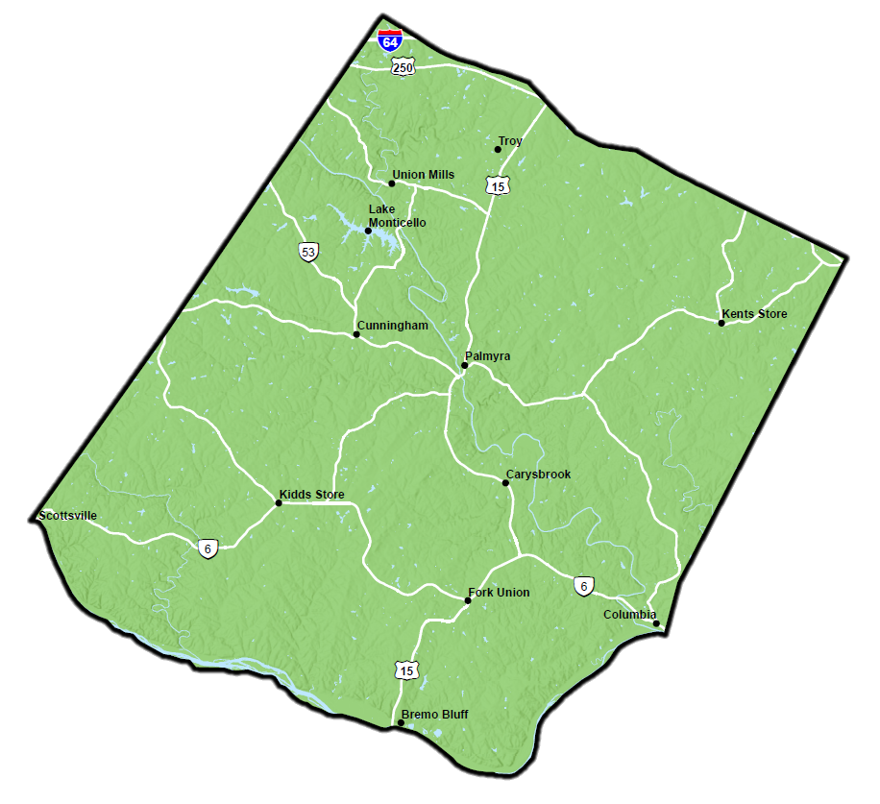
Rai Amendment Site Location

Slide 5
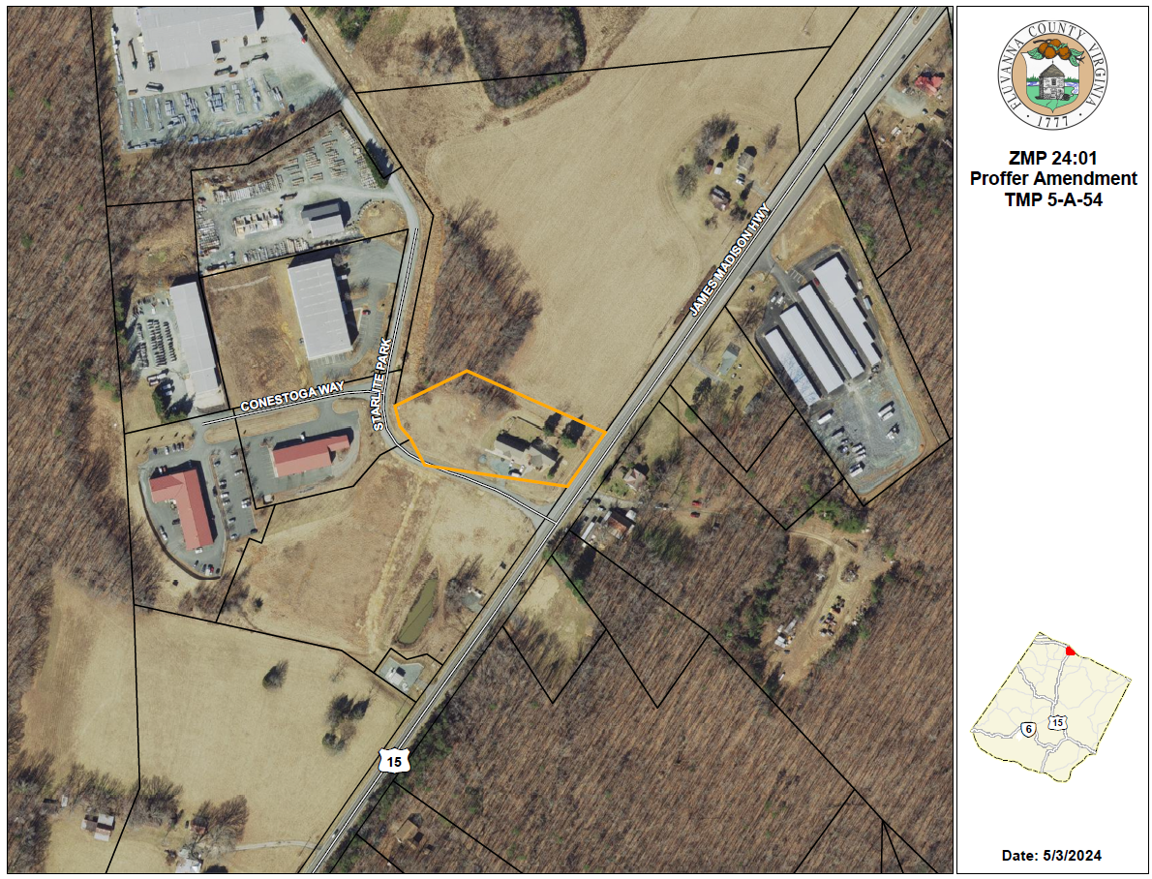
Rai Amendment Parcel Map

Slide 6
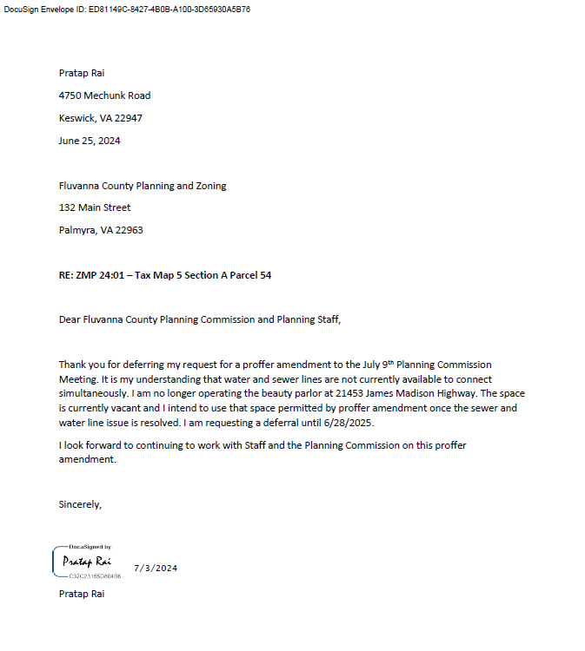
Rai Proffer Amendment – Signed Deferral Req.

Slide 7
Planning Commissioners Discussion
ZMP 24:01 Rai Proffer Amendment Request

Slide 8
ZMP 24:01 Planning Commission Motion
I move that the Planning Commission (approve / deny) the request for a deferral of ZMP 24:01, an ordinance to amend the proffer statement of ZMP 09:04 with respect to 1.27 acres of Tax Map 5 Section A Parcel 54, until June 28, 2025.

