Slide 1
SDP 24:07 Antioch Baptist Church Site Development Plan
Tuesday, December 10, 2024
Todd Fortune
Director of Planning

Slide 2
SDP 24:07 - Overview
Antioch Baptist Church has submitted a Site Development Plan for a multi-purpose building to be constructed adjacent to the existing social hall on Tax Map 26 Section A Parcel 15.
The property is zoned A-1 and is in the Rural Preservation planning area.
Proposed building will be 21,117 square feet and 1.5 stories.
Alternative septic system permits have been issued by VDH.
Existing eastern access point will be upgraded to a moderate volume commercial entrance. VDOT may have additional requirements.
87 new parking spaces including 6 ADA van accessible spaces.

Slide 3
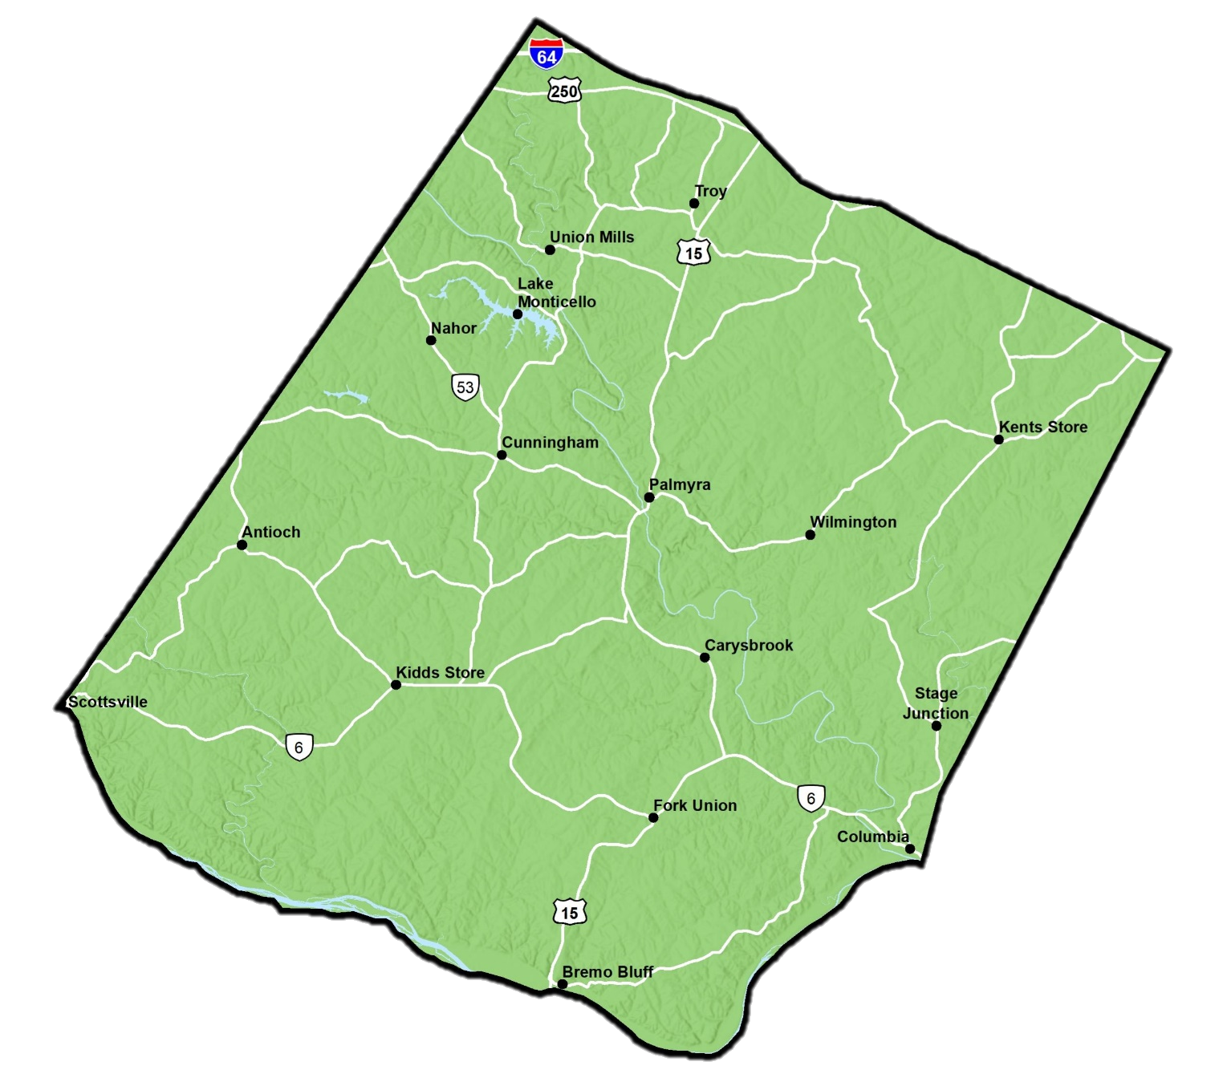
SDP 24:07 - Site Location

Slide 4
SDP 24:07 - Parcel Map

Slide 5
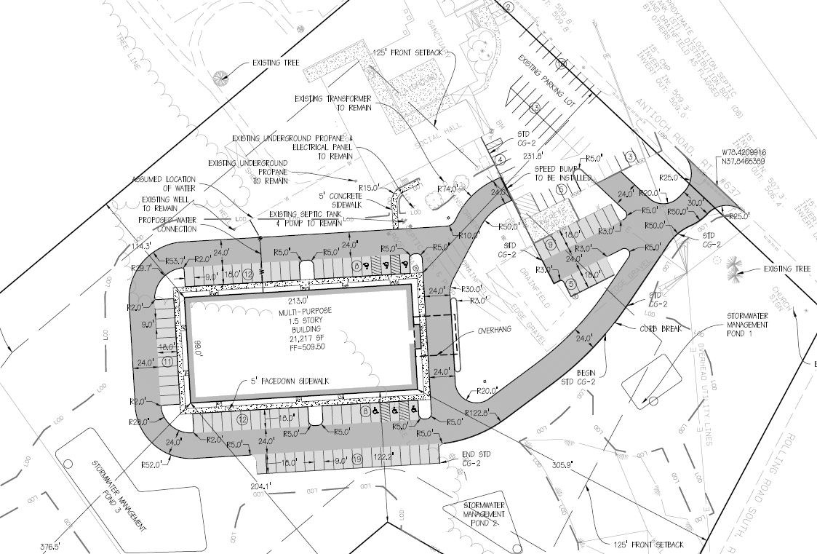
SDP 24:07 - Site Development Plan

Slide 6
SDP 24:07 - Planning Commission Motion
I move that the Planning Commission accept SDP 24:07, a sketch plan request to construct a 21,117-square-foot multi-purpose building in the A-1, Agricultural, General District on 9.3 ± acres identified as Tax Map 26 Section A Parcel 15.

