Slide 1
Zoning Text Amendment Event Permits
Planning Commission
December 10, 2024
Todd Fortune
Director of Planning

Slide 2
ZTA – Event Permits
It has come to the attention of staff that a number of events have been held, or are being held in the near future, in the County that attract large crowds. These events currently do not require permits.
A main issue that has arisen is the need for staff from Fluvanna County Emergency Services to be informed in advance so they can arrange to provide coverage for these events
At the October 8, 2024 meeting, the Planning Commission discussed a possible Zoning Text Amendment to regulate such events.
A number of questions were discussed by the Commission:
Should event permits be subject to approval by the Board of Supervisors, or approved administratively?
Should there be a fee for event permits?
Should events held by Fluvanna County or Fluvanna County Public Schools be exempt from permit requirements?
How much time before an event should a permit application be submitted?
What attendance level (how many people) should trigger the requirement for a permit?

Slide 3
ZTA – Event Permits
Staff presented some information on how surrounding localities address permits for events.
The Commission instructed staff to conduct additional research to include additional localities, to see how they handle event permits.
A comprehensive list is included in the following slides.
On a related note, the Fluvanna County Sheriff’s Office is working to set up a system that would allow for event organizers to coordinate on providing coverage.
The system is still in development, no launch date at this time.
It would involve a private vendor contracting with the Sheriff’s Office to track deputy coverage at events, and arrange for event organizers to pay for that coverage through the vendor.

Slide 4
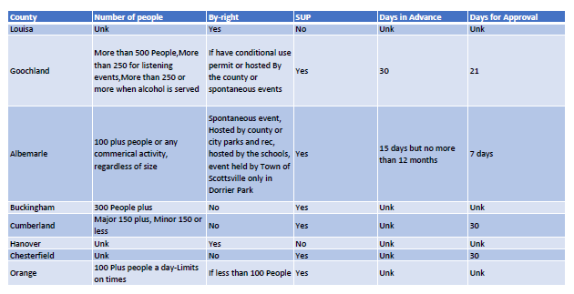
ZTA – Event Permits
Policies from neighboring counties:

Slide 5
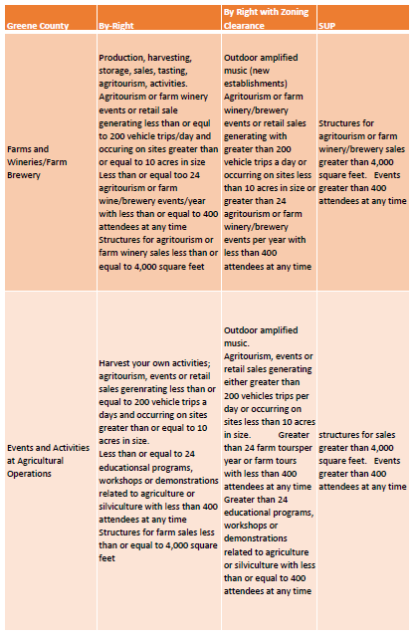
ZTA – Event Permits
Policies from
neighboring counties:

Slide 6
ZTA – Event Permits
Staff is seeking guidance from the Planning Commission on whether to draft a Zoning Text Amendment to cover regulations for event permitting.
If one is drafted, a resolution would be presented to the Planning Commission for consideration at its January 2025 meeting.
If approved a public hearing on the amendment would be held in February 2025.

